Slide 1
Ckj hotel & resorts
Har chun wai
Tan kang hong
Lau jun dian
Ho jing xian

Slide 2
contents
(1)
Login & register
(2)
User dashboard
(3)
reservation
(4)
payment

Slide 3
(1) Login & register

Slide 4
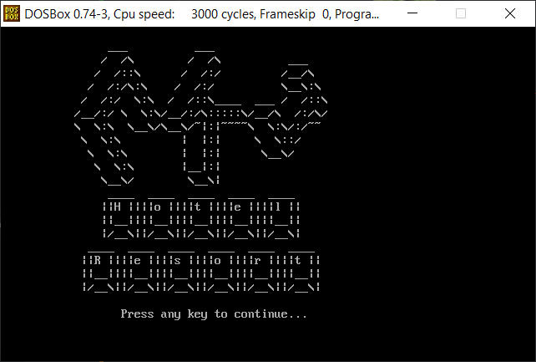
LOGO
Beginning of the program
Occurred once

Slide 5
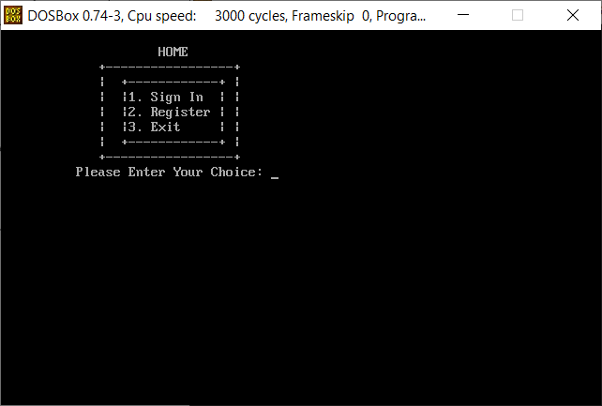
HOME PAGE
Sign in, register & exit

Slide 6
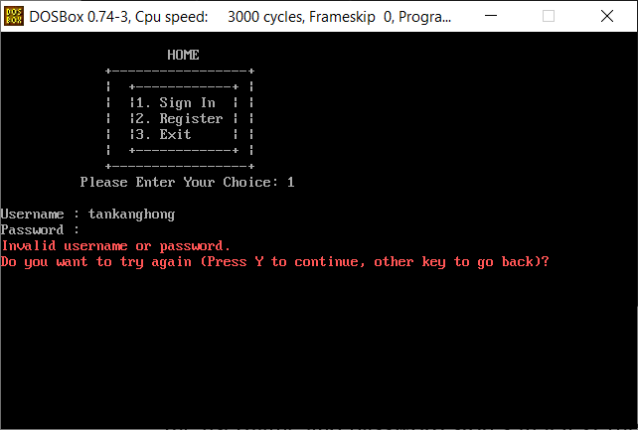
Sign in
Cursor did not move while entering password
Username & password validation

Slide 7
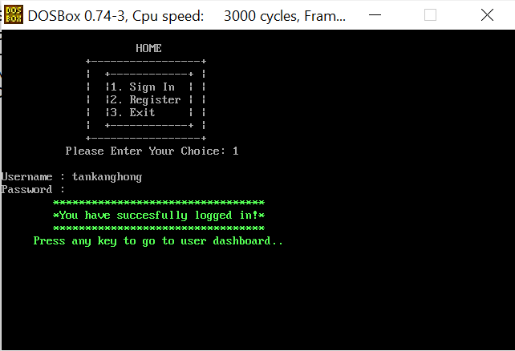
Sign in
Signed in successfully

Slide 8
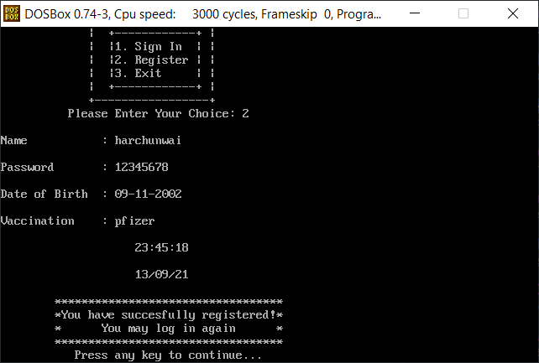
REGISTER
Stores in a txt file
Gets date and time when successfully registered

Slide 9
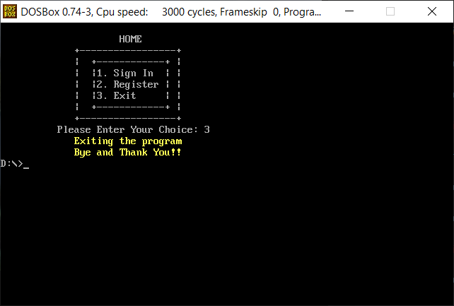
EXIT
Exits the program

Slide 10
(2) User dashboard

Slide 11
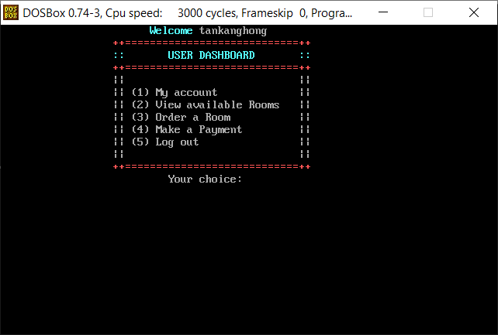
User dashboard
Welcome message

Slide 12
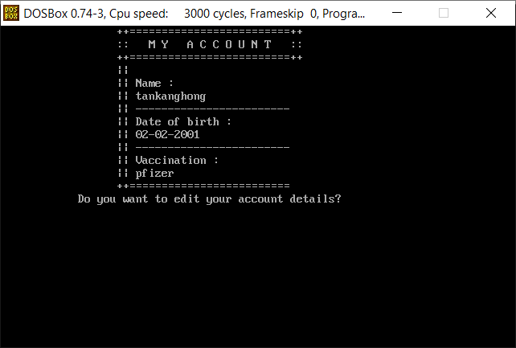
My account
View user profile
Ask to Edit details

Slide 13
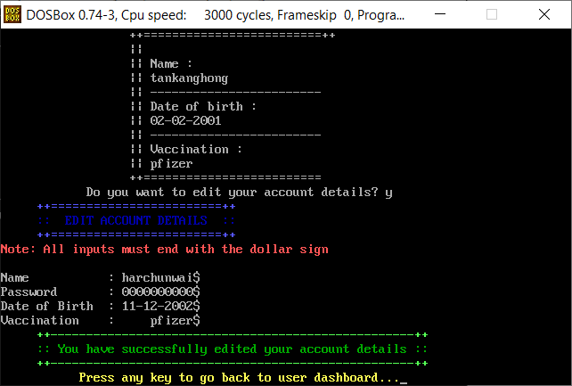
edit account
Resets the details before inputting the new one

Slide 14
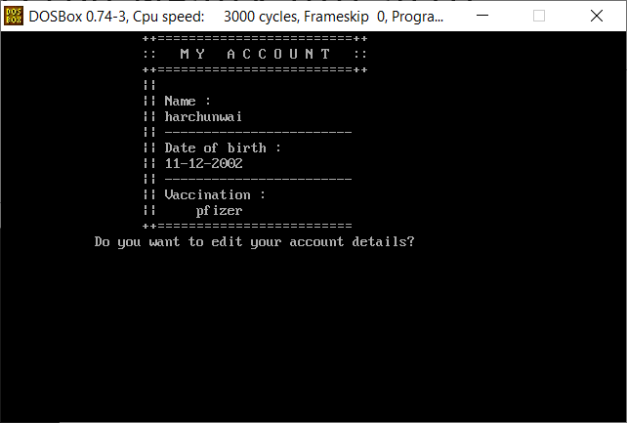
edit account
before
after

Slide 15
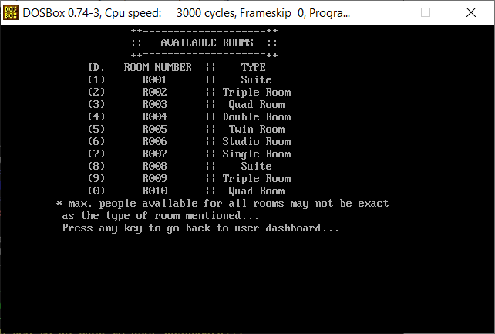
View available rooms
View the list of rooms in advance

Slide 16
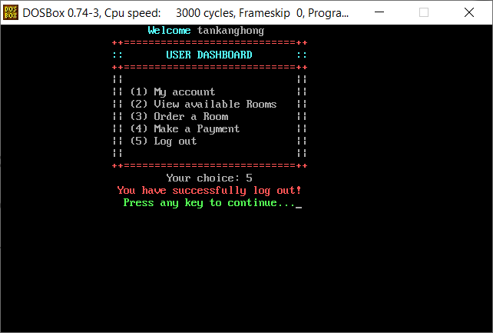
(3) Order a room: reservation
(4) Make a payment: payment
(5) Log out

Slide 17
(3) reservation

Slide 18
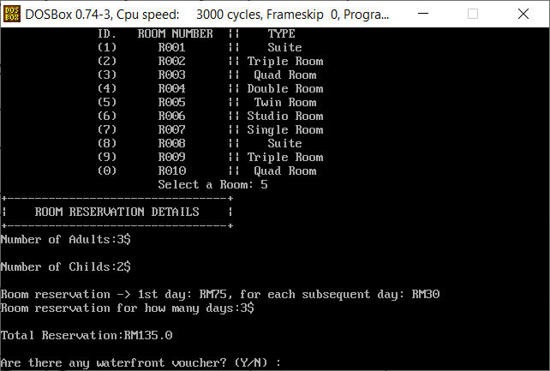
reservation
Select a room
No. of adults, childs
Reservation fee

Slide 19
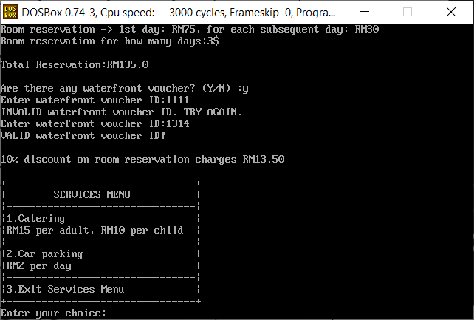
reservation
Waterfront voucher (10% to reservation charge)
Services menu

Slide 20
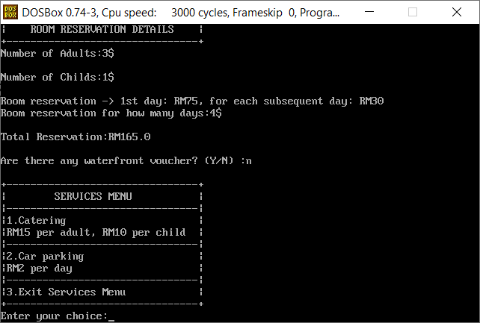
Services menu
Provide extra charges to the reservation fees
Catering: RM15 per adult, RM10 per child
Car parking: RM2 per reservation days
Exit services menu: proceed to next segment

Slide 21
(4) payment

Slide 22
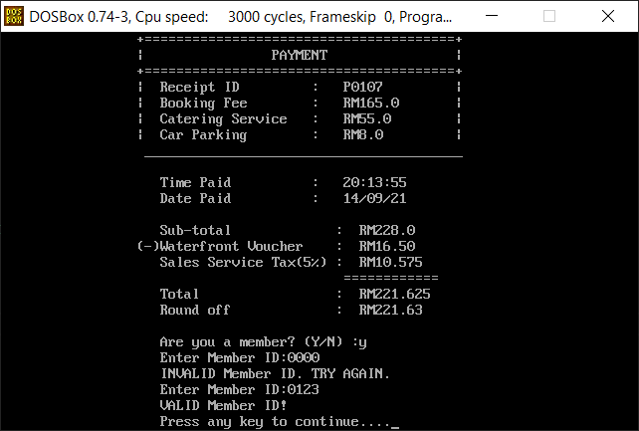
payment
Receipt ID:
P010 <random number>
Retrieve date and time that the receipt has generated
Sales Service Tax (SST) = 5%
Member
Round off

Slide 23
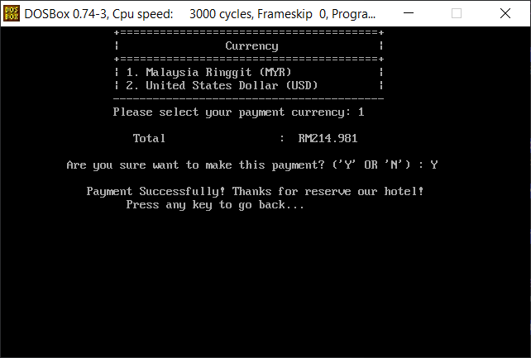
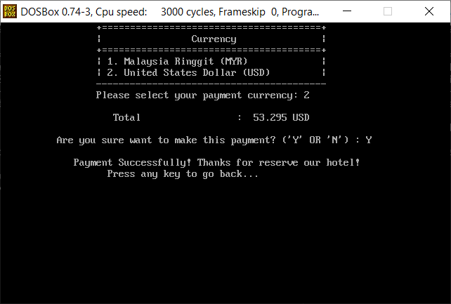
currency
1 USD = RM 4
myr
usd

Slide 24
THANK YOU

